Slide 1
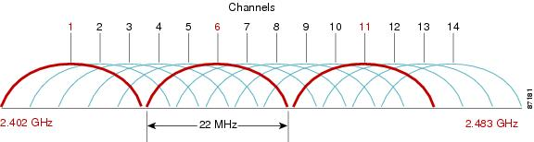
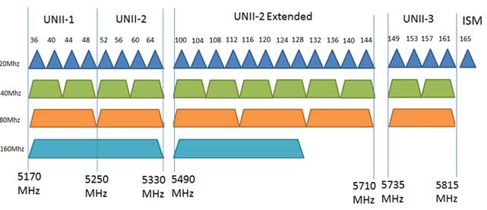
(a) 2.4 GHz band
(b) 5 GHz band

